Slide 1
Imperfect Competition and Market Power: Core Concepts
imperfectly competitive industry An industry in which individual firms have some control over the price of their output.
market power An imperfectly competitive firm’s ability to raise price without losing all of the quantity demanded for its product.
Forms of Imperfect Competition and Market Boundaries
A monopoly is an industry with a single firm in which the entry of new firms is blocked.
An oligopoly is an industry in which there is a small number of firms, each large enough so that its presence affects prices.
Firms that differentiate their products in industries with many producers and free entry are called monopolistic competitors.
pure monopoly An industry with a single firm that produces a product for which there are no close substitutes and in which significant barriers to entry prevent other firms from entering the industry to compete for profits.

Slide 2
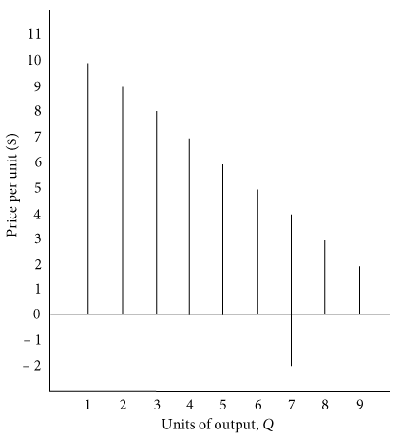
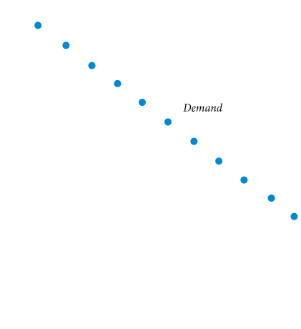
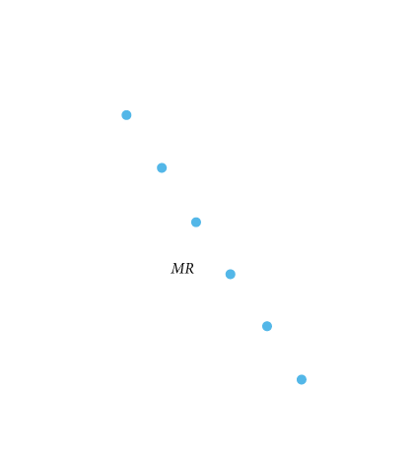
Price and Output Decisions in Pure Monopoly Markets
Demand in Monopoly Markets
Marginal Revenue and Market Demand
TABLE 13.1 Marginal Revenue Facing a Monopolist
(1) Quantity |  | (2) Price |  | (3) Total Revenue |  | (4) Marginal Revenue
0 |  | $11 |  | 0 |  | –
1 |  | 10 |  | $10 |  | $10
2 |  | 9 |  | 18 |  | 8
3 |  | 8 |  | 24 |  | 6
4 |  | 7 |  | 28 |  | 4
5 |  | 6 |  | 30 |  | 2
6 |  | 5 |  | 30 |  | 0
7 |  | 4 |  | 28 |  | −2
8 |  | 3 |  | 24 |  | −4
9 |  | 2 |  | 18 |  | −6
10 |  | 1 |  | 10 |  | −8
① FIGURE 13.2 Marginal Revenue Curve Facing a Monopolist
At every level of output except 1 unit, a monopolist’s marginal revenue (MR) is below price.
This is so because (1) we assume that the monopolist must sell all its product at a single price (no price discrimination) and (2) to raise output and sell it, the firm must lower the price it charges.
Selling the additional output will raise revenue, but this increase is offset somewhat by the lower price charged for all units sold. Therefore, the increase in revenue from increasing output by 1 (the marginal revenue) is less than the price.

Slide 3
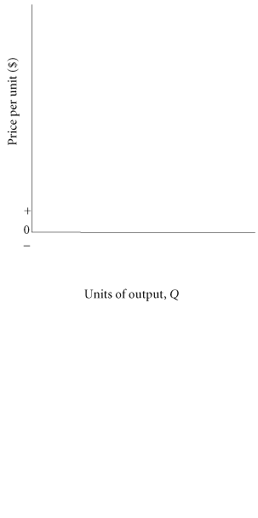
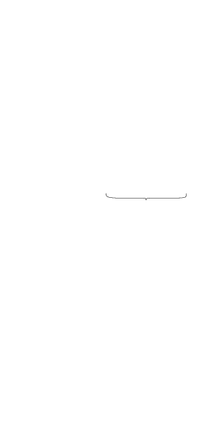


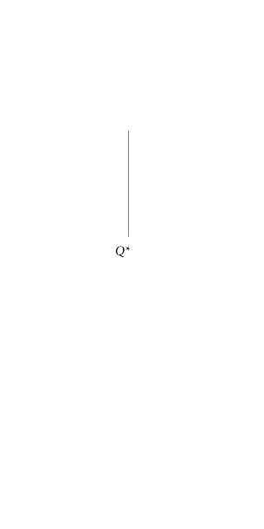
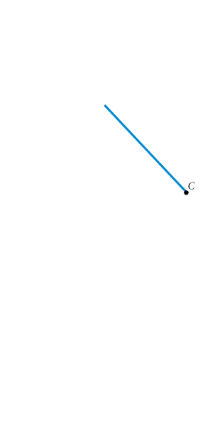
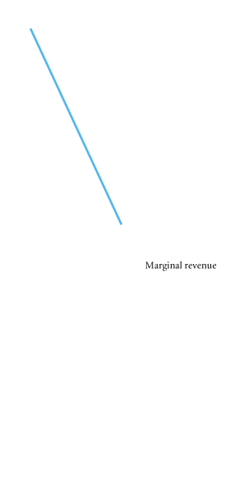
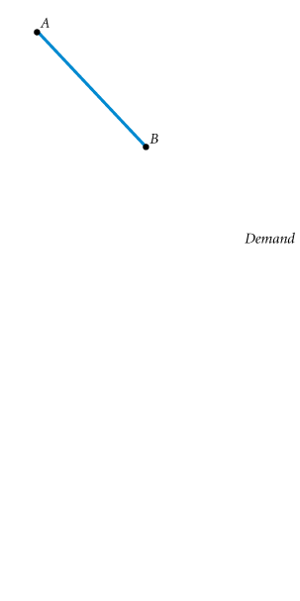
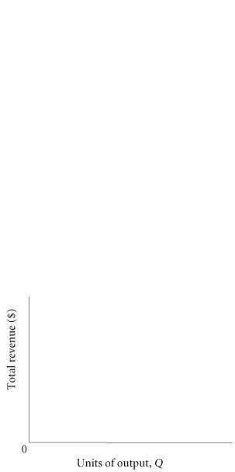
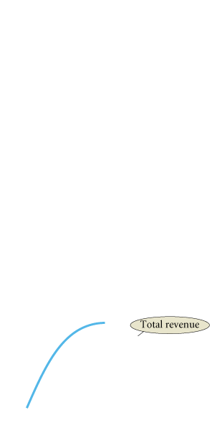

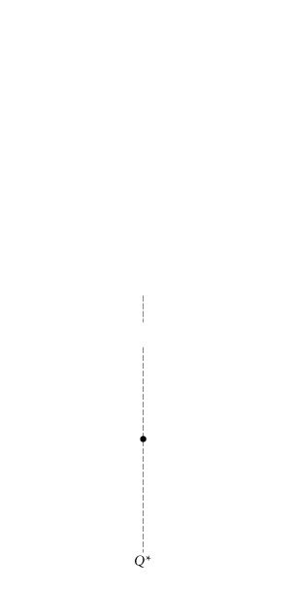

④ FIGURE 13.3 Marginal Revenue and Total Revenue
A monopoly’s marginal revenue curve bisects the quantity axis between the origin and the point where the demand curve hits the quantity axis.
A monopoly’s MR curve shows the change in total revenue that results as a firm moves along the segment of the demand curve that lies exactly above it.

Slide 4
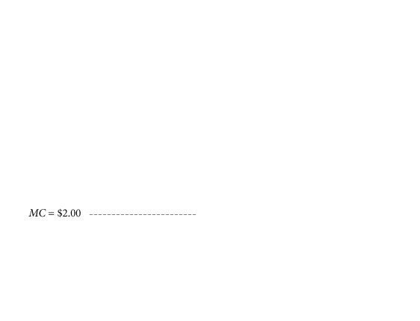

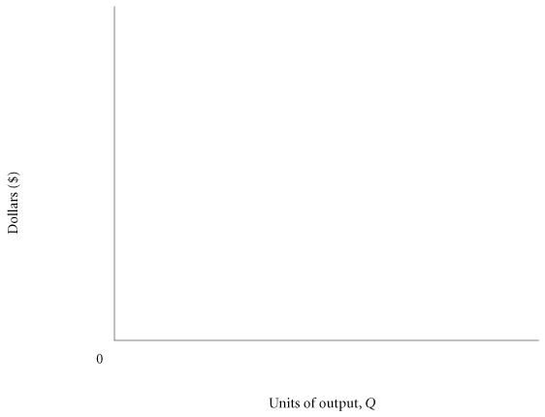
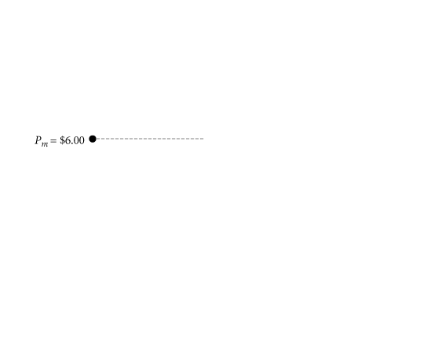
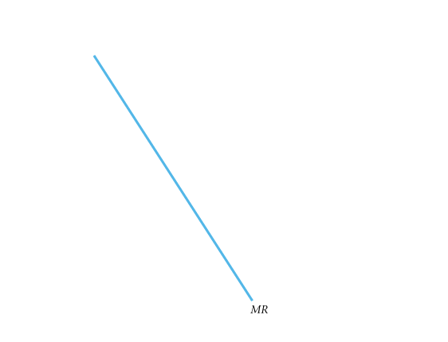
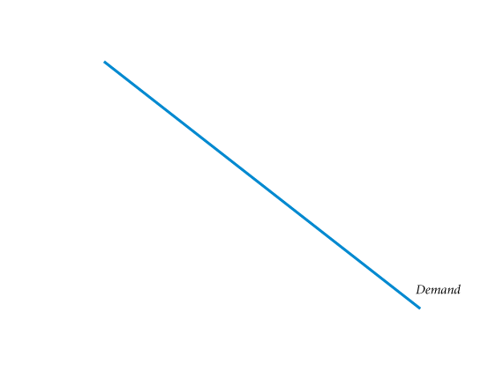
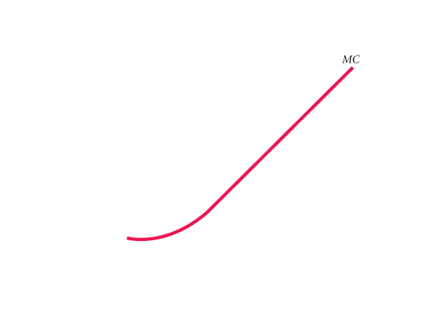
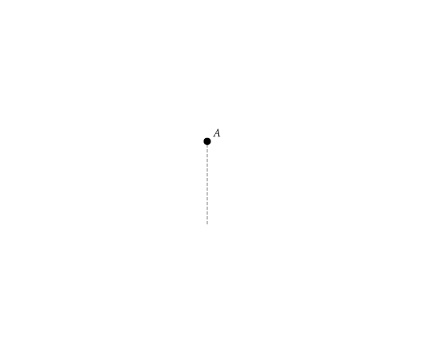
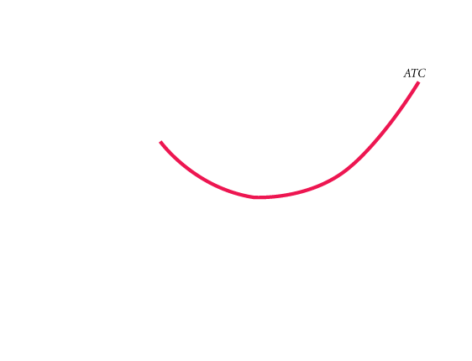
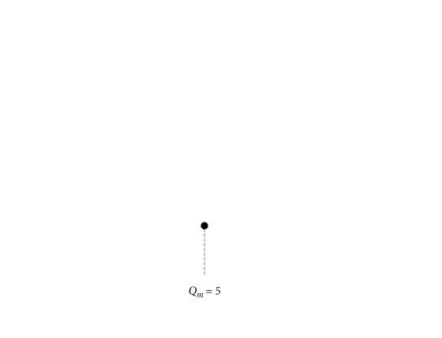
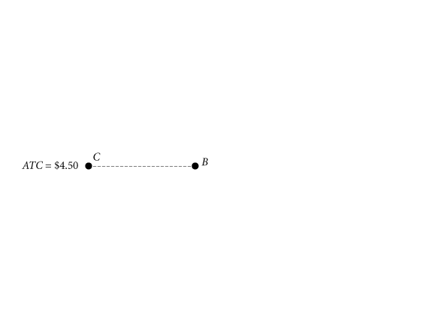
The Monopolist’s Profit-Maximizing Price and Output
④ FIGURE 13.4 Price and Output Choice for a Profit-Maximizing Monopolist
A profit-maximizing monopolist will raise output as long as marginal revenue exceeds marginal cost.
Maximum profit is at an output of 5 units per period and a price of $6.
Above 5 units of output, marginal cost is greater than marginal revenue;
increasing output beyond 5 units would reduce profit.
At 5 units, TR = P_{m}AQ_{m}0, TC = CBQ_{m}0, and profit = P_{m}ABC.

Slide 5
The Absence of a Supply Curve in Monopoly
A monopoly firm has no supply curve that is independent of the demand curve for its product.
A monopolist sets both price and quantity, and the amount of output that it supplies depends on its marginal cost curve and the demand curve that it faces.

Slide 6
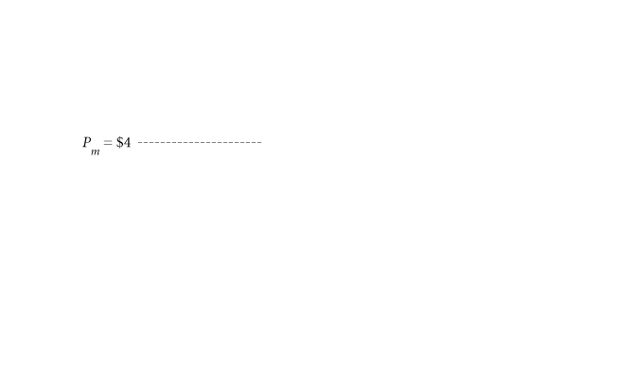
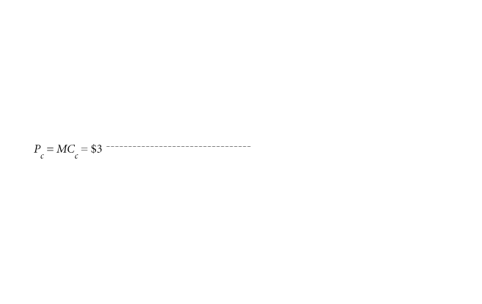
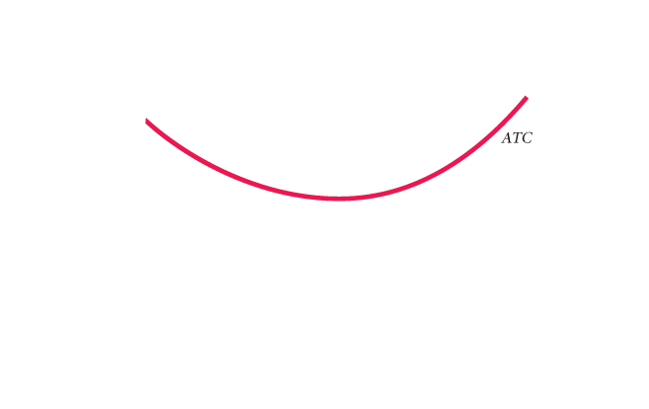
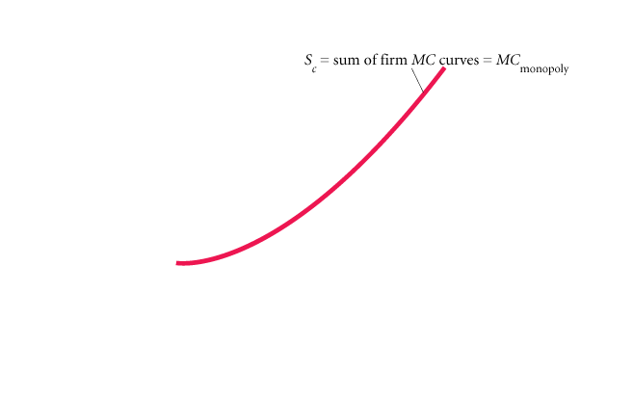
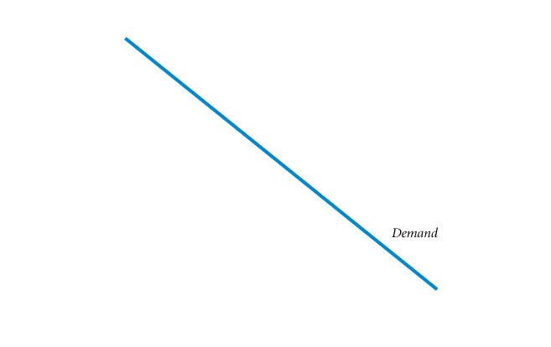
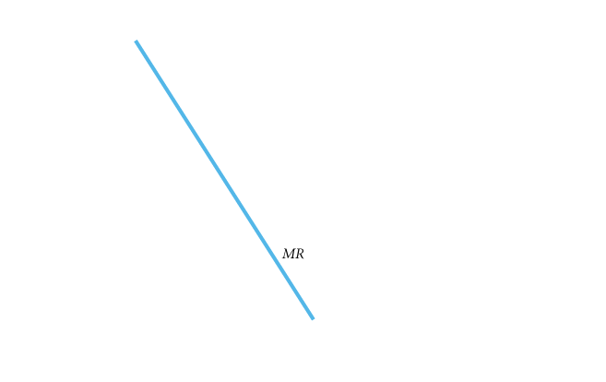
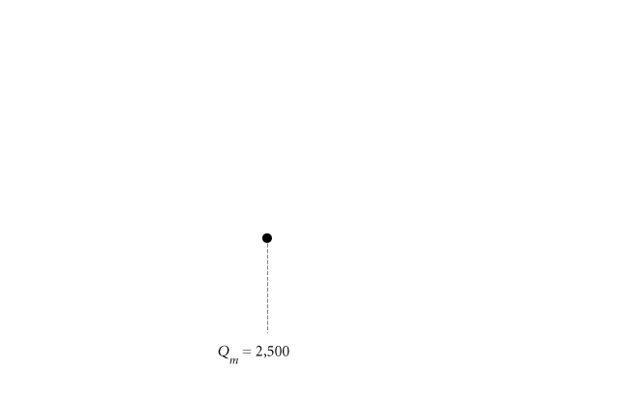
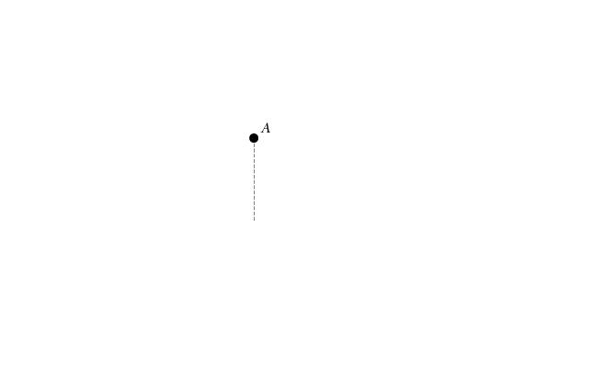
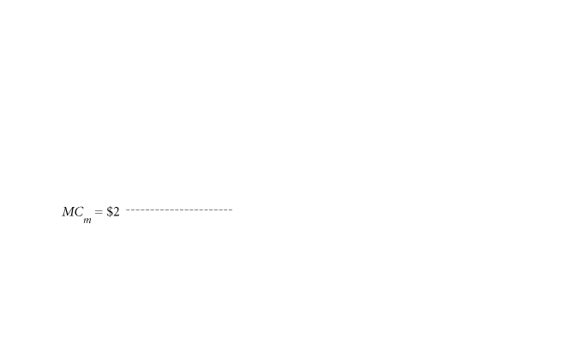
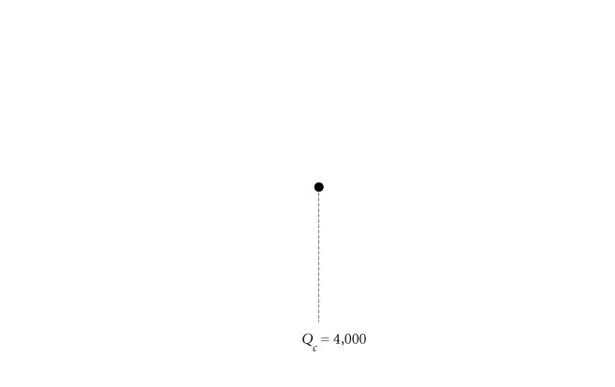
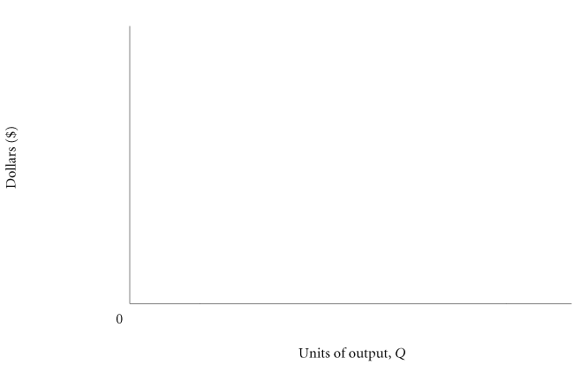
① FIGURE 13.6 Comparison of Monopoly and Perfectly Competitive Outcomes for a Firm with Constant Returns to Scale
In the newly organized monopoly, the marginal cost curve is the same as the supply curve that represented the behavior of all the independent firms when the industry was organized competitively.
Quantity produced by the monopoly will be less than the perfectly competitive level of output, and the monopoly price will be higher than the price under perfect competition.
Under monopoly, P = P_{m} = $4 and Q = Q_{m} = 2,500.
Under perfect competition, P = P_{c} = $3 and Q = Q_{c} = 4,000.

Slide 7
Monopoly in the Long Run: Barriers to Entry
barriers to entry Factors that prevent new firms from entering and competing in imperfectly competitive industries.
Economies of Scale
natural monopoly An industry that realizes such large economies of scale that single-firm production of that good or service is most efficient.

Slide 8
Industry Characteristics
monopolistic competition A common form of industry (market) structure characterized by a large number of firms, no barriers to entry, and product differentiation.
TABLE 15.1 Percentage of Value of Shipments Accounted for by the Largest Firms in Selected Industries, 2002
Industry Designation | Four Largest Firms |  | Eight Largest Firms |  | Twenty Largest Firms |  | Number of Firms
Travel trailers and campers | 38 |  | 45 |  | 58 |  | 733
Games, toys | 39 |  | 48 |  | 63 |  | 732
Wood office furniture | 34 |  | 43 |  | 56 |  | 546
Book printing | 33 |  | 54 |  | 68 |  | 560
Curtains and draperies | 17 |  | 25 |  | 38 |  | 1,778
Fresh or frozen seafood | 14 |  | 24 |  | 48 |  | 529
Women’s dresses | 18 |  | 23 |  | 48 |  | 528
Miscellaneous plastic products | 6 |  | 10 |  | 18 |  | 6,775

Slide 9
Product Differentiation and Advertising
product differentiation A strategy that firms use to achieve market power.
Accomplished by producing goods that differ from others in the market.
How Many Varieties?
In well-working markets, the level of product variety reflects the underlying heterogeneity of consumers’ tastes in that market, the gains if any from coordination, and cost economies from standardization.
In industries that are monopolistically competitive, differences in consumer tastes, lack of need for coordination, and modest or no scale economies from standardization give rise to a large number of firms, each of which has a different product.

Slide 10
How Do Firms Differentiate Products?
horizontal differentiation Products differ in ways that make them better for some people and worse for others.
vertical differentiation A product difference that, from everyone’s perspective, makes a product better than rival products.
behavioral economics A branch of economics that uses the insights of psychology and economics to investigate decision making.

Slide 11
oligopoly A form of industry (market) structure characterized by a few dominant firms. Products may be homogenous or differentiated.
Oligopolists compete with one another not only in price but also in developing new products, marketing and advertising those products, and developing complements to use with the products.

Slide 12
Macro Economic Aggregates

Slide 13

Measuring National Output and National Income
Gross Domestic Product
Final Goods and Services
Exclusion of Used Goods and Paper Transactions
Exclusion of Output Produced Abroad by Domestically Owned Factors of Production
Calculating GDP
The Expenditure Approach
The Income Approach
Nominal versus Real GDP
Calculating Real GDP
Calculating the GDP Deflator
The Problems of Fixed Weights
Limitations of the GDP Concept
GDP and Social Welfare
The Informal Economy
Gross National Income per Capita

Slide 14
national income and product accounts Data collected and published by the government describing the various components of national income and output in the economy.

Slide 15
Gross Domestic Product
gross domestic product (GDP) The total market value of all final goods and services produced within a given period by factors of production located within a country.
GDP is the total market value of a country’s output. It is the market value of all final goods and services produced within a given period of time by factors of production located within a country.
Final Goods and Services
final goods and services Goods and services produced for final use.
intermediate goods Goods that are produced by one firm for use in further processing by another firm.
value added The difference between the value of goods as they leave a stage of production and the cost of the goods as they entered that stage.

Slide 16
In calculating GDP, we can sum up the value added at each stage of production or we can take the value of final sales. We do not use the value of total sales in an economy to measure how much output has been produced.

